Slide 1
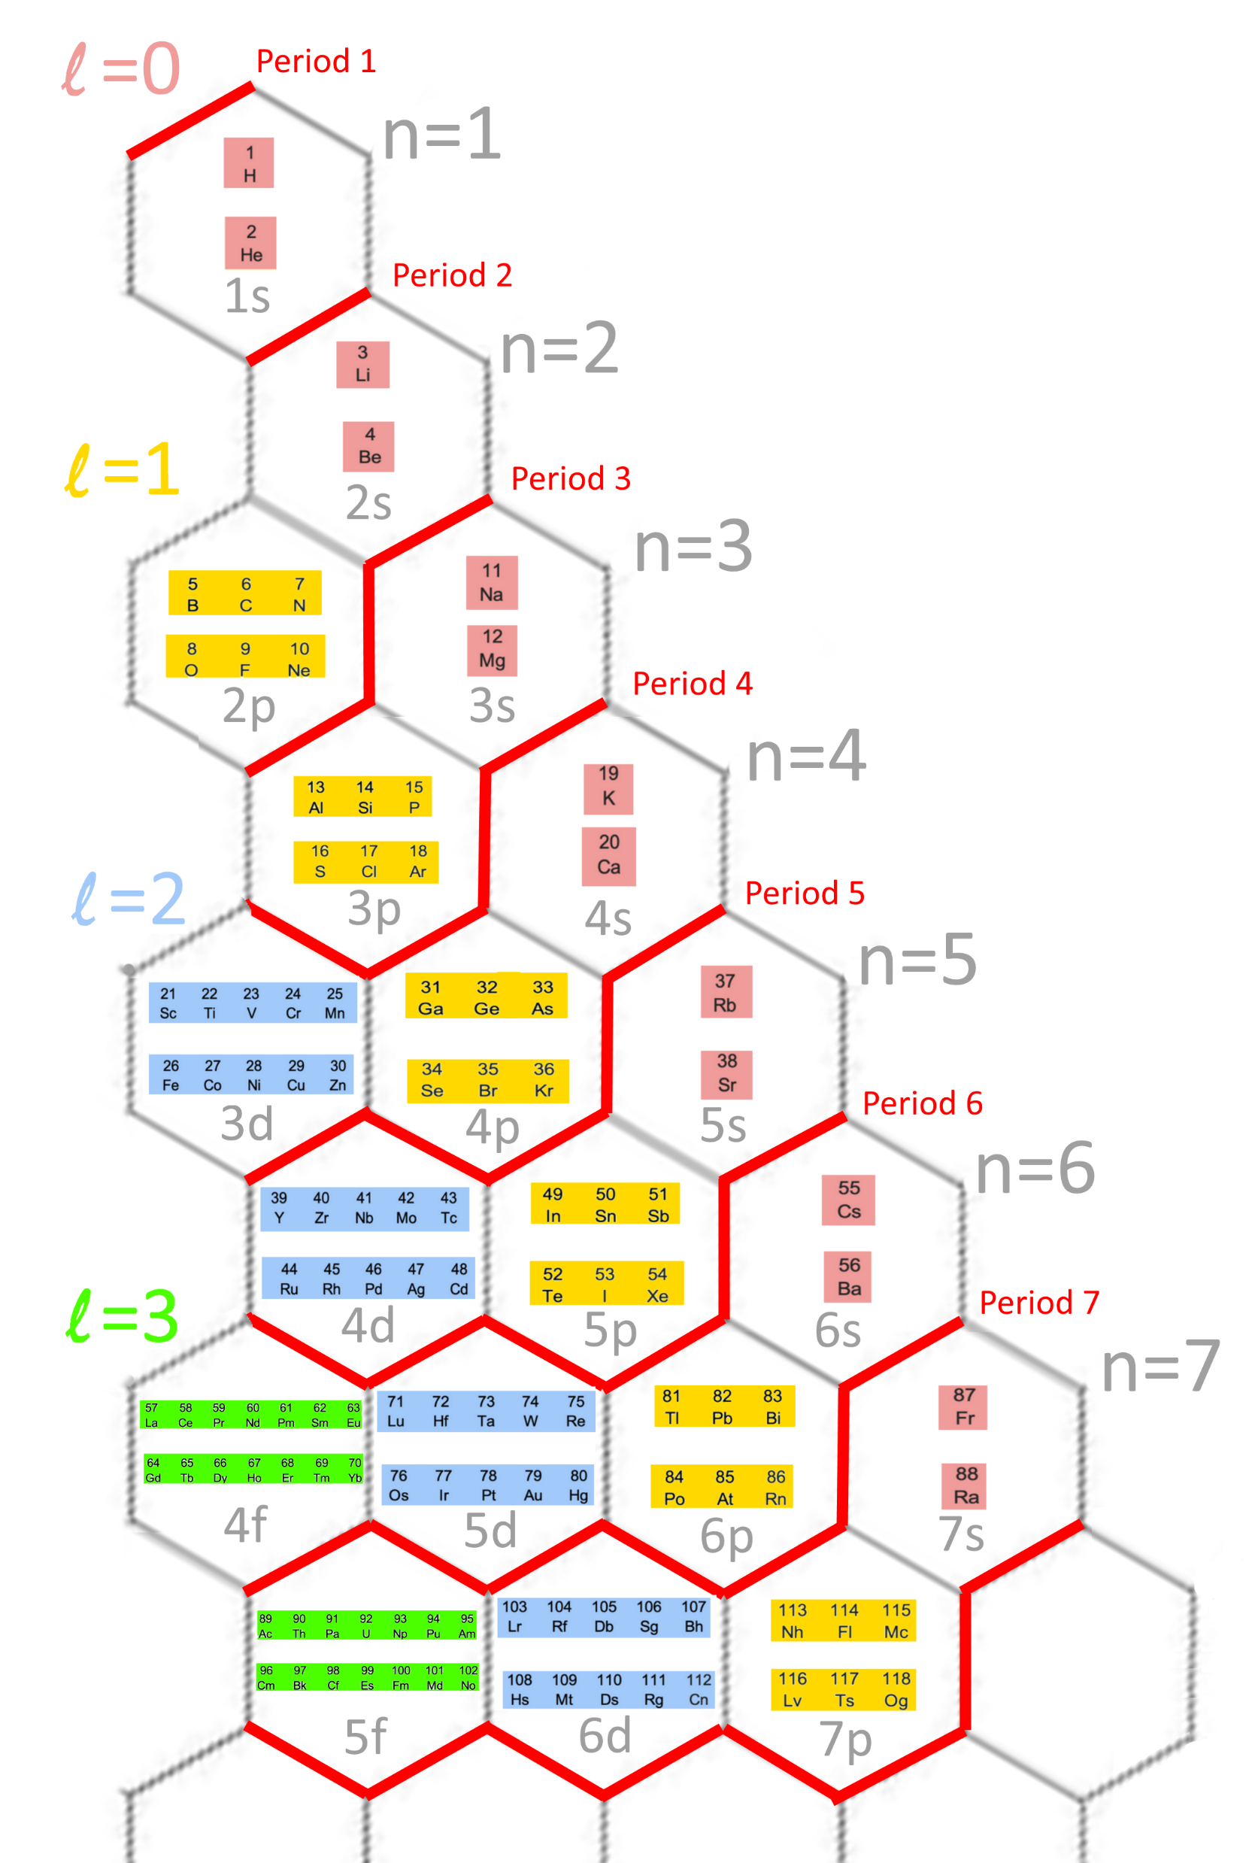
HexaFrame periodic table

Slide 2
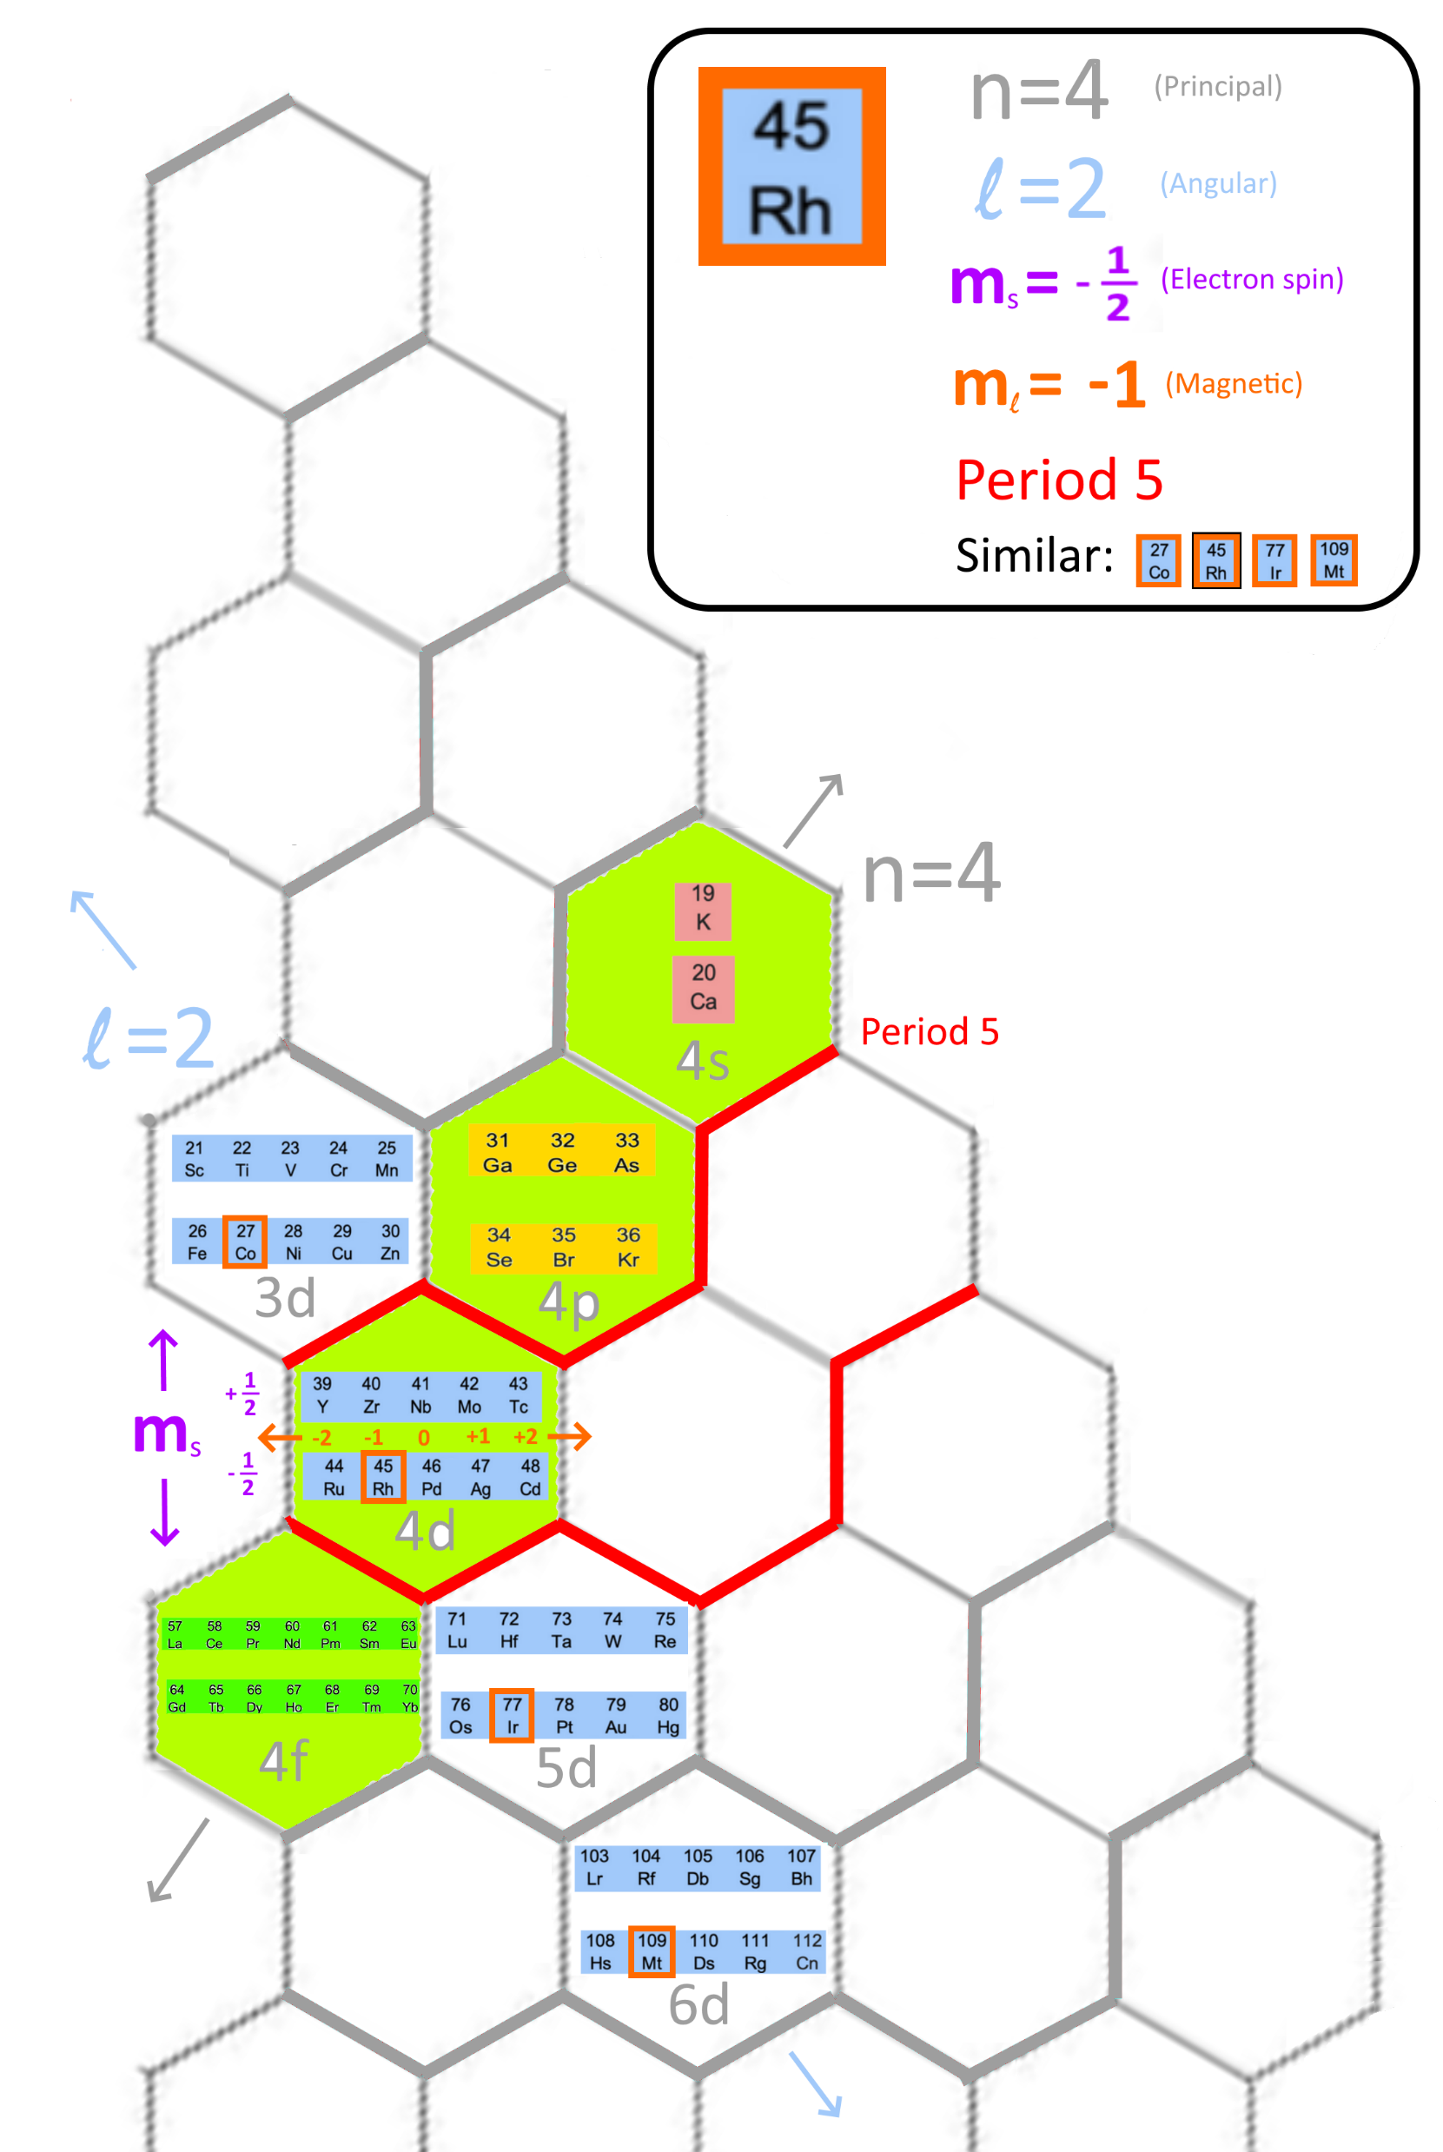
Pro: Coordinates can determine quantum numbers (QNs) easily
Quantum Numbers (QNs) and other info | Traditional Table | HexaFrame Table
Principal QN (n) | Less intuitive | Easy
Angular QN (l) | Easy | Easy
Electron spin QN (m_{s}) | Less intuitive | Easy
Magnetic QN (m_{l}) | Difficult | Easy
Period | Easy | Easy
Similar elements | Easy | Easy

Slide 3
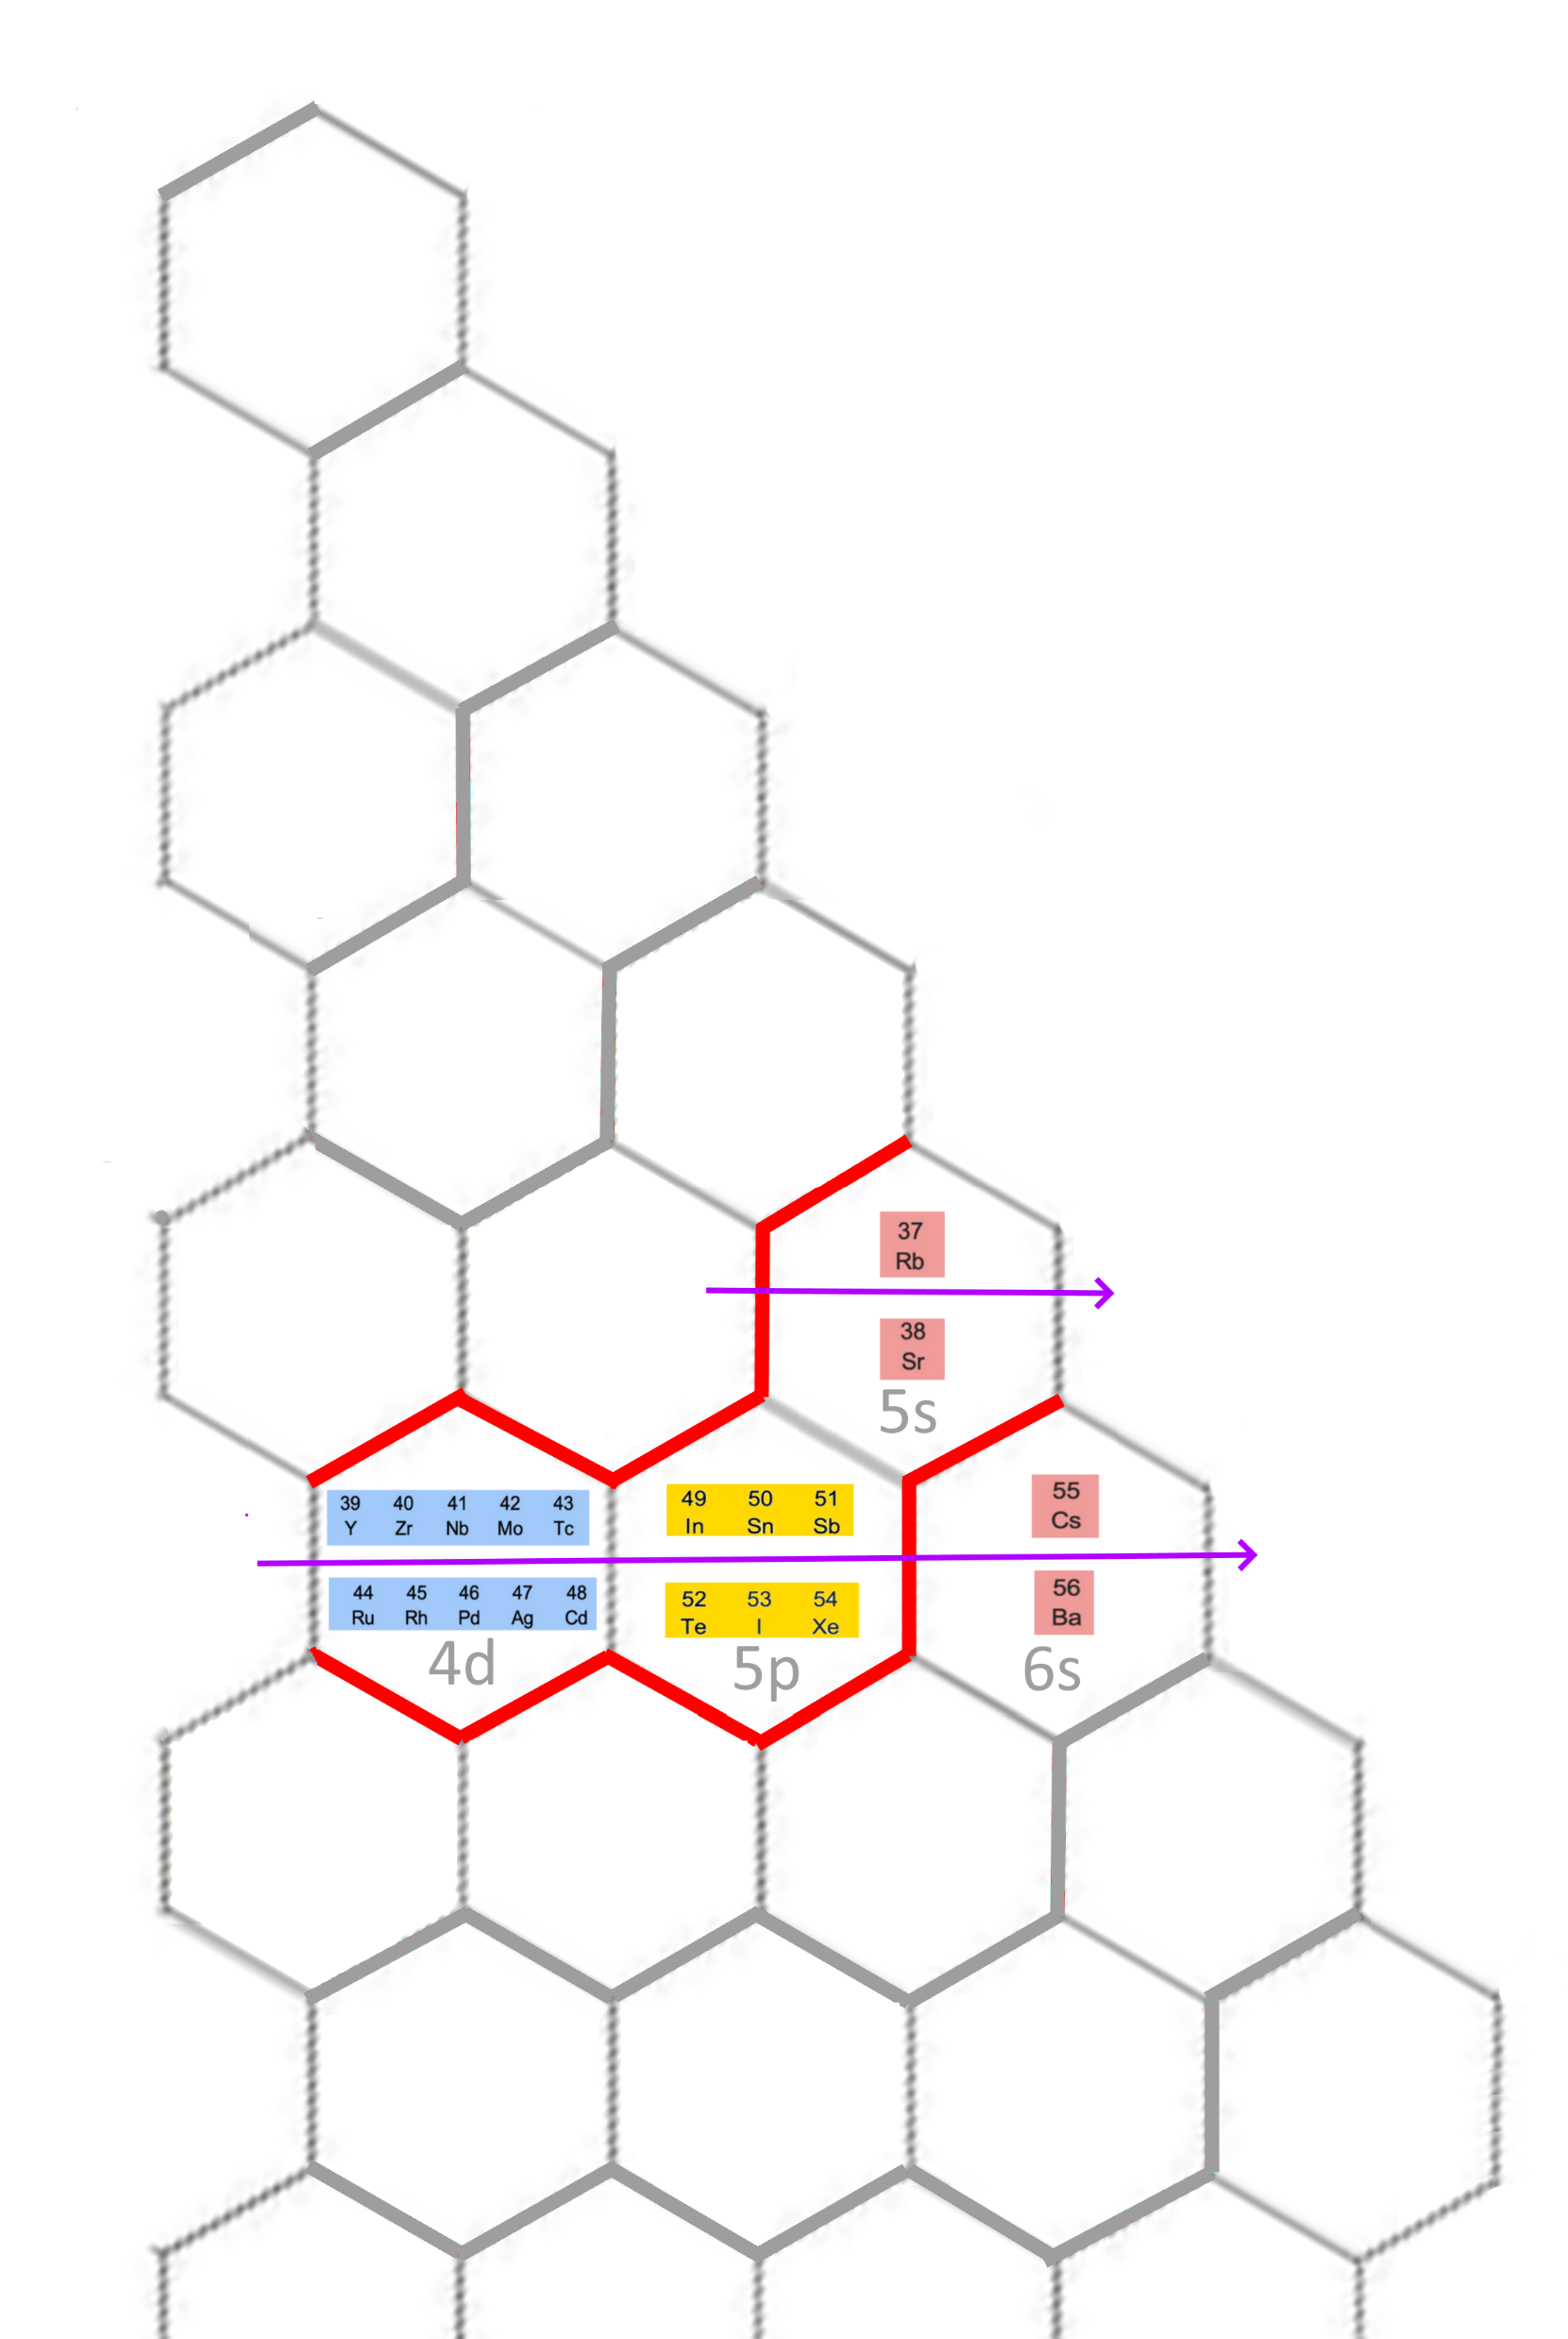
Pro: Perform element number accounting easily
 | Reflected in Traditional Table | Reflected in HexaFrame Table
Electron filling order of elements e.g. Rb 37 → Sr 38 → Y 39… | Yes | Yes
Electron filling order of subshells e.g. 5s → 4d → 5p → 6s … | Less intuitive | Yes
No. of elements of block (s:p:d:f = 1:3:5:7) | Difficult to see | Yes
Number of elements of each period | Less intuitive | Yes e.g. Period 5: (1 + 3 + 5)*2

Slide 4
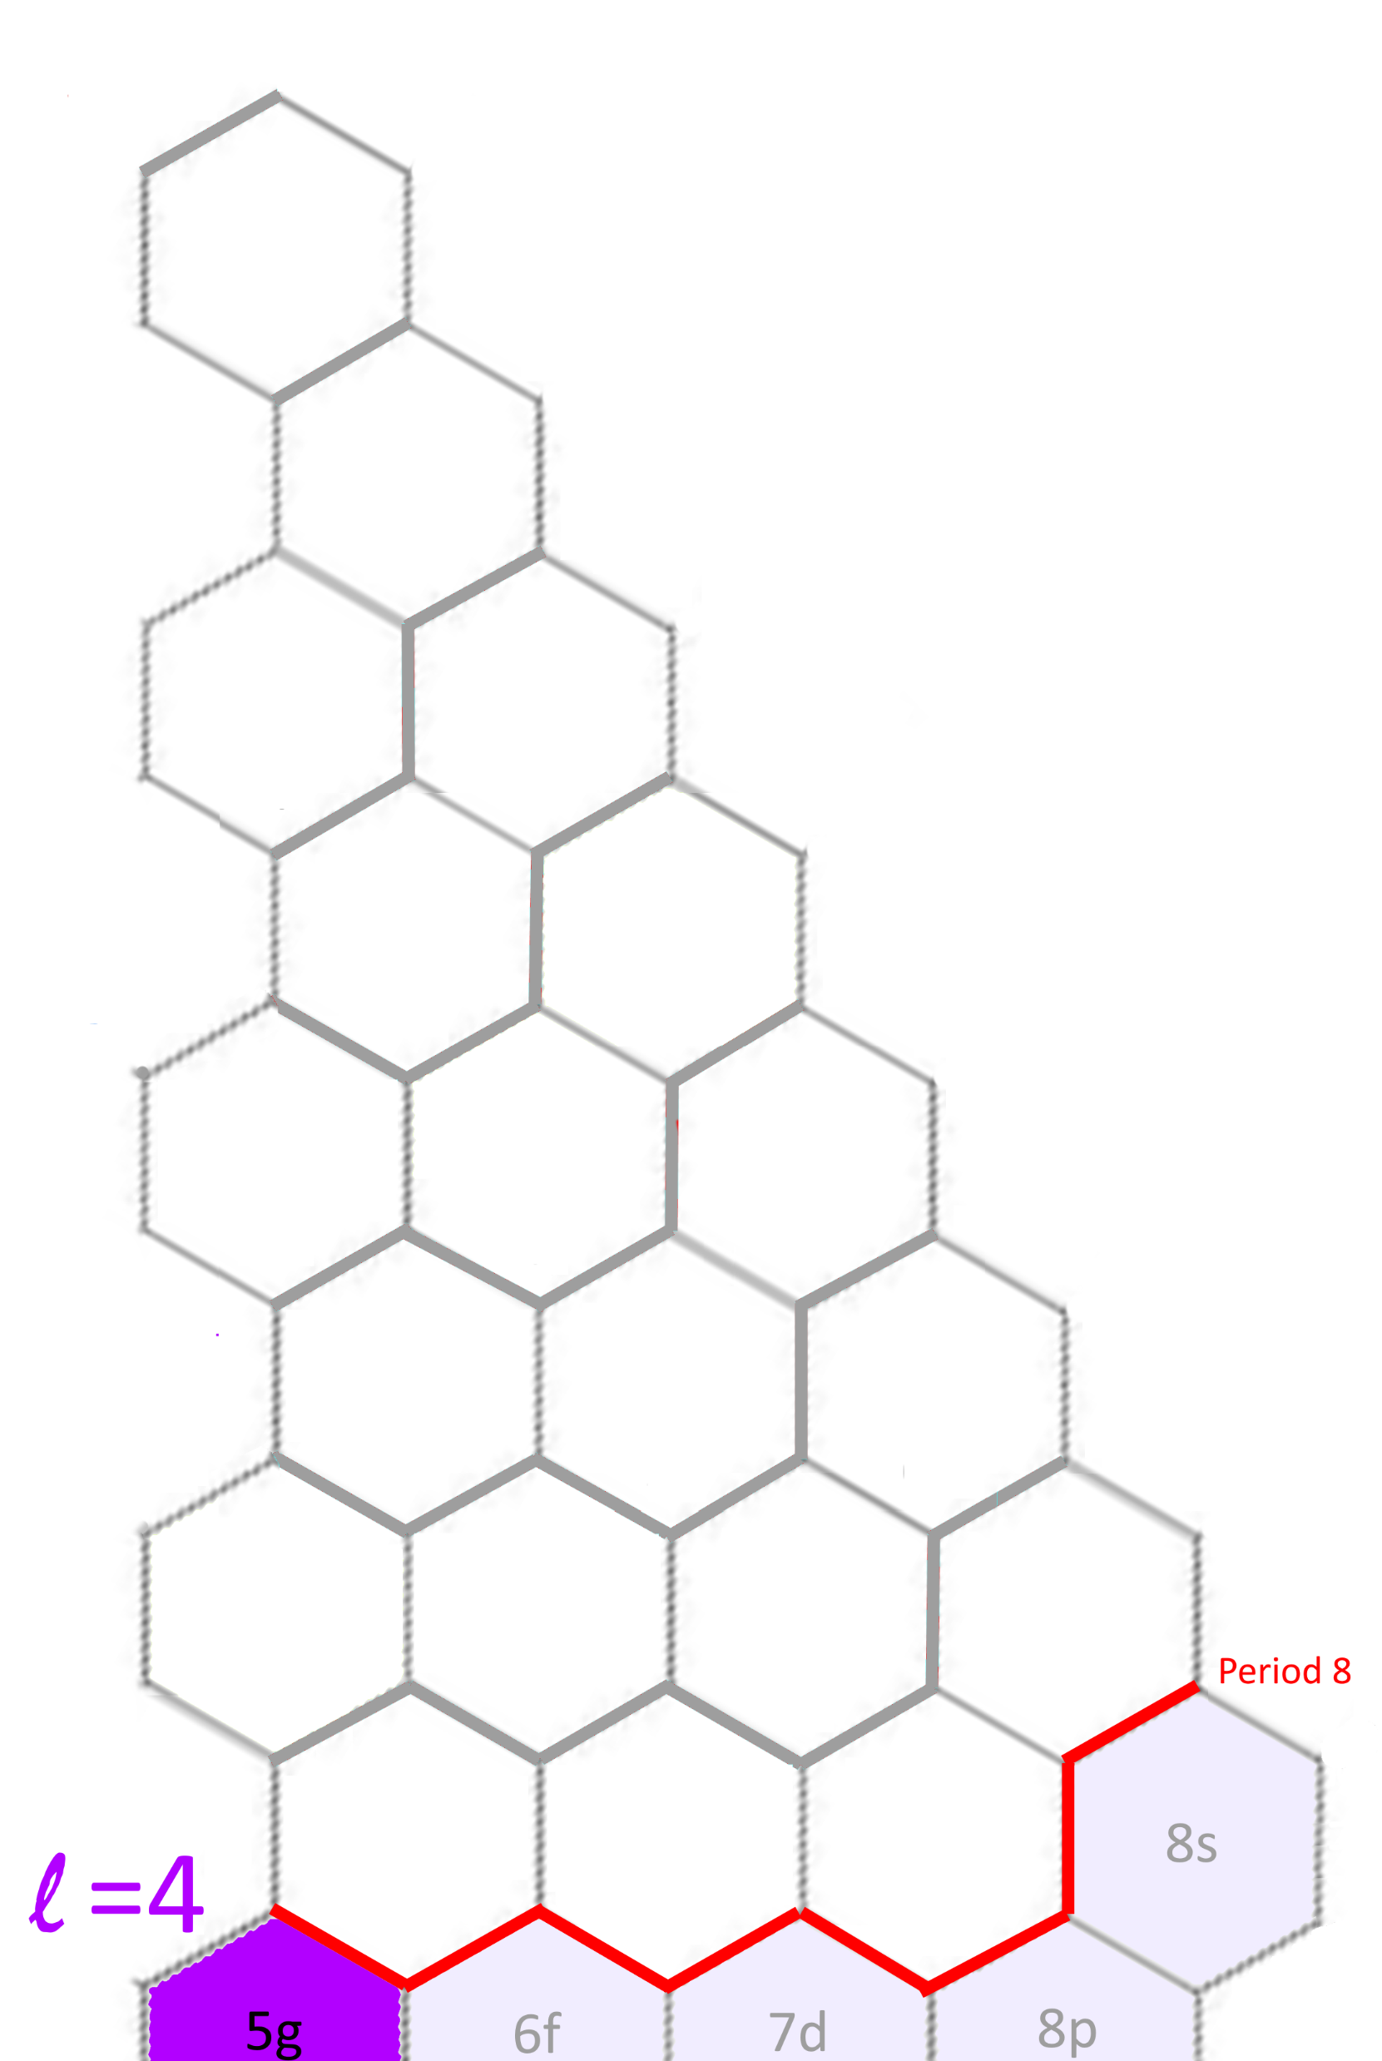
Pro: Can be extended easily
 | Traditional Table | HexaFrame Table
Extend to period 8 | Need to find new space for block g | Already have a place for block g

Slide 5
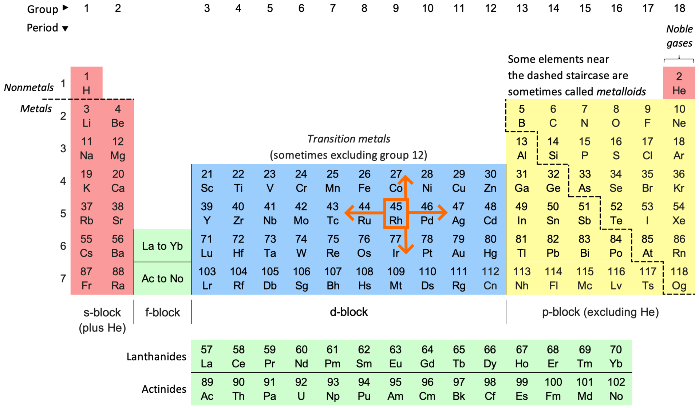
References
Blog post: The HexaFrame Periodic Table
Other possible form of periodic table: Wikipedia
Traditional regtangular periodic table:

